Slide 1
Reducing Customer Churn: A Data-Driven Retention StrategyReducing Customer Churn: A Data-Driven Retention Strategy
By : Yvonne Rajula

Slide 2
Overview
Goal: To build a predictive model that identifies customers at high risk of leaving (churning).
Value Proposition: By predicting churn before it happens, the company can proactively intervene with targeted retention offers, saving revenue and reducing customer acquisition costs.
Key Finding: Our models can successfully distinguish between loyal and at-risk clients 81% of the time.

Slide 3
Business and Data Understanding
The Problem: Customer churn directly impacts the bottom line. Understanding why and who is leaving is critical for growth.
The Data: Analyzed 3,333 customer records containing 21 features, including:
Usage Patterns: Day, evening, and international call minutes/charges.
Account Details: Account length, area codes, and specific service plans (International/Voice Mail).
Customer Feedback: Number of customer service calls made.
Data Insight: Only ~14.5% of customers in the dataset churned, requiring specialized techniques (like SMOTE) to ensure the model could recognize this minority group accurately.

Slide 4
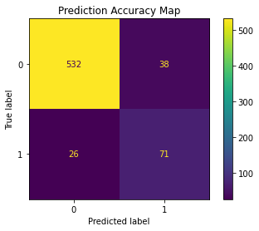
Modeling Strategy
Approach: We tested two primary industry-standard methods to ensure reliability:
Logistic Regression: A statistical model used to determine the probability of an event (churn).
Decision Tree: A logic-based model that maps out customer characteristics to reach a prediction.
Ensuring Fairness: We utilized a "Pipeline" approach to standardize data and handle the imbalance in churned vs. non-churned customers, ensuring the results aren't biased toward the majority.

Slide 5
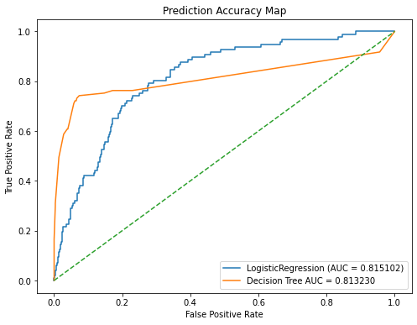
Performance Evaluation
Success Metric (AUC): Both models achieved an AUC of 0.81.
What this means for you:
The models have "good discrimination ability".
In plain terms: If you pick one churned customer and one loyal customer at random, the model will correctly identify the at-risk customer 81% of the time.
Consistency: The identical performance across different model types confirms the stability of our predictions.

Slide 6
Key Drivers of Churn (Recommendations)
Based on the data analysis, stakeholders should focus on:
Customer Service Interventions: High correlation exists between customer service calls and churn. Customers calling frequently are likely frustrated and need immediate attention.
High Usage Costs: Total day minutes and charges are significant indicators of churn. Consider offering "Unlimited" or "High-Volume" loyalty tiers for these power users.
Plan Optimization: International plans and their associated charges should be reviewed to ensure they remain competitive.

Slide 7

Next Steps
Pilot Program: Deploy the Decision Tree model on a small subset of current customers to test real-world predictive accuracy.
1
Proactive Retention: Equip the customer service team with "Save Desk" offers specifically for customers flagged by the model.
2
Feedback Loop: Regularly update the model with new customer data to account for changing market trends and competitor offers.
3

Slide 8
Conclusion & Thank You
Summary: We have developed a tool that provides an 81% accuracy rate in identifying at-risk clients, directly supporting a data-backed customer retention strategy.
Call to Action: Let's integrate these insights into the CRM to start reducing churn this quarter.
Questions?

Slide 9

Slide Style Checklist Notes for the Presenter:
Visuals: Use the ROC curves and Confusion Matrices generated in the notebook as visuals for Slides 4 and 5, but label them in plain language (e.g., "Prediction Accuracy Map").
Text Density: Keep bullet points to one line where possible to ensure the slides are light on text and easily readable.

